Slide 1
GRADE 7 ACCELERATED · UNIT 1 · LESSON 1
Rewriting Numbers in Equivalent Forms
MA.7.NSO.1.2
I can write a rational number as a fraction, a decimal or a percentage, and use bar notation when the decimal repeats.
First lesson of the unit.
Every decimal either stops or repeats. Today we learn to tell which.
Grade 7 Accelerated · Unit 1 · Lesson 1 — Rewriting Numbers in Equivalent Forms
1

Slide 2

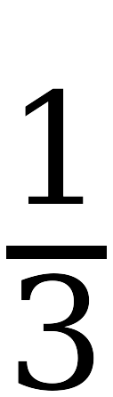

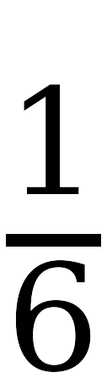

Warm-Up
On your own. Four minutes. No dividing yet.
Predict, then check
Which of these turn into decimals that never stop? Decide before you divide.
Write down how you decided, without dividing.
Grade 7 Accelerated · Unit 1 · Lesson 1 — Rewriting Numbers in Equivalent Forms
2

Slide 3
Notes
I. Every rational number's decimal stops or repeats
A.
rational number — a ratio of two integers
B.
terminating decimal — a decimal that stops
C.
repeating decimal — never stops, repeats a pattern forever
D.
One or the other. There is no third kind.
Grade 7 Accelerated · Unit 1 · Lesson 1 — Rewriting Numbers in Equivalent Forms
3

Slide 4
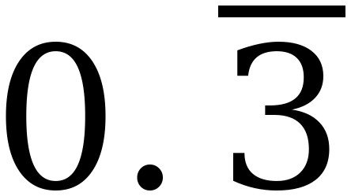
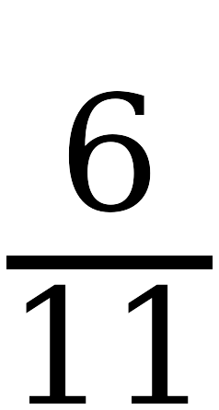
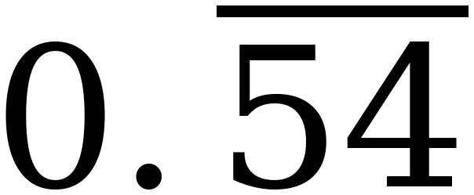
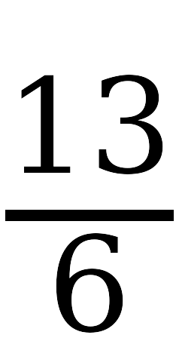
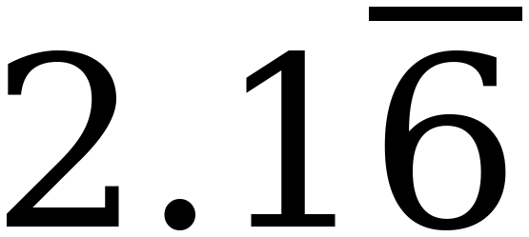
Notes
II. The bar covers the repeating digits only
A.
bar notation — a bar drawn over the digits that repeat
B.
The bar covers the repeating digits and nothing else.
C.
Write the bar, not the ellipsis. Never both.
=
0.333…
=
=
0.545454…
=
=
2.1666…
=
Grade 7 Accelerated · Unit 1 · Lesson 1 — Rewriting Numbers in Equivalent Forms
4

Slide 5
Notes
III. Simplify first — the denominator lies until you do
A.
6/15 looks like a fifteenth. It is 2/5 = 0.4, and it stops.
B.
A fraction's denominator tells you nothing at all until the fraction is in lowest terms.
C.
Simplify, then look. Every time.
Grade 7 Accelerated · Unit 1 · Lesson 1 — Rewriting Numbers in Equivalent Forms
5

Slide 6
Notes
IV. Divide, and watch the remainders
A.
If a remainder you have already had comes back, the digits cycle forever.
B.
If the division reaches a remainder of 0, the decimal stops.
C.
Denominators that gave a repeat today: 3, 6, 9, 11, 15 — and that same 15 also gave one that stopped.
Grade 7 Accelerated · Unit 1 · Lesson 1 — Rewriting Numbers in Equivalent Forms
6

Slide 7
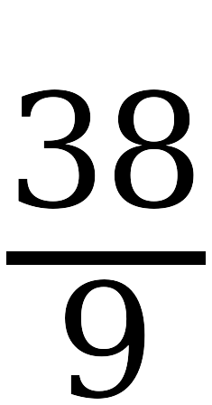
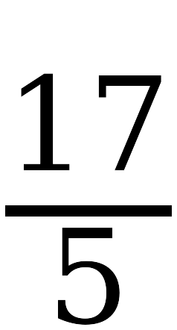
Example 1
Whiteboards. Decimal first, then the second column.
Fraction
Decimal
Stops or repeats?
Grade 7 Accelerated · Unit 1 · Lesson 1 — Rewriting Numbers in Equivalent Forms
7

Slide 8
Example 1
The decimals.
Fraction
Decimal
Stops or repeats?
0.333…
repeats
0.375
stops
2.1666…
repeats
4.222…
repeats
3.4
stops
Grade 7 Accelerated · Unit 1 · Lesson 1 — Rewriting Numbers in Equivalent Forms
8

Slide 9
Example 1
Now in bar notation.
=
=
Grade 7 Accelerated · Unit 1 · Lesson 1 — Rewriting Numbers in Equivalent Forms
9

Slide 10
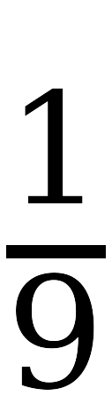


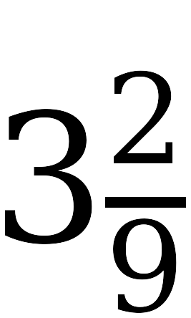

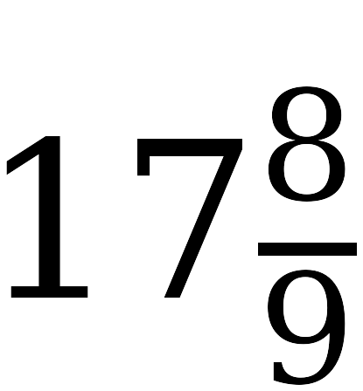
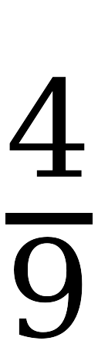


Example 2
Fill the left column. Do not touch the right one yet.
Fraction
Decimal
Predict
Decimal
Grade 7 Accelerated · Unit 1 · Lesson 1 — Rewriting Numbers in Equivalent Forms
10

Slide 11
Example 2
The pattern.
Fraction
Decimal
0.111…
0.222…
The numerator IS the repeating digit.
0.333…
0.444…
0.555…
0.666…
Grade 7 Accelerated · Unit 1 · Lesson 1 — Rewriting Numbers in Equivalent Forms
11

Slide 12
Example 2
Now predict the right column.
Predict
Decimal
0.777…
3.222…
17.888…
Grade 7 Accelerated · Unit 1 · Lesson 1 — Rewriting Numbers in Equivalent Forms
12

Slide 13
Example 3
Divide 5 by 9 on the TI-30XA.
0.555555556
Example 2 said 5/9 = 0.555… Is the calculator wrong?
Grade 7 Accelerated · Unit 1 · Lesson 1 — Rewriting Numbers in Equivalent Forms
13

Slide 14
Example 3
Neither is wrong.
A.
The screen holds ten digits. The last one is rounded.
B.
The 6 on the end is the calculator, not the pattern.
C.
Read the pattern from the middle of the display. Never from the last digit.
Grade 7 Accelerated · Unit 1 · Lesson 1 — Rewriting Numbers in Equivalent Forms
14

Slide 15
Example 3
And Desmos disagrees with it.
Desmos shows more digits and rounds in a different place.
Grade 7 Accelerated · Unit 1 · Lesson 1 — Rewriting Numbers in Equivalent Forms
15

Slide 16
Whiteboards · Question 1 of 9
Boards up on three.
Write it as a decimal.
One value. Bar notation where it repeats.
Grade 7 Accelerated · Unit 1 · Lesson 1 — Rewriting Numbers in Equivalent Forms
16

Slide 17
Whiteboards · Question 1 of 9
Answer.
3 ÷ 8 = 0.375, and it stops
Answer: 0.375
Grade 7 Accelerated · Unit 1 · Lesson 1 — Rewriting Numbers in Equivalent Forms
17

Slide 18
Whiteboards · Question 2 of 9
Boards up on three.
Now write it as a percent.
One value. Bar notation where it repeats.
Grade 7 Accelerated · Unit 1 · Lesson 1 — Rewriting Numbers in Equivalent Forms
18

Slide 19
Whiteboards · Question 2 of 9
Answer.
0.375 × 100
Answer: 37.5%
Grade 7 Accelerated · Unit 1 · Lesson 1 — Rewriting Numbers in Equivalent Forms
19

Slide 20
Whiteboards · Question 3 of 9
Boards up on three.
Write it as a decimal.
One value. Bar notation where it repeats.
Grade 7 Accelerated · Unit 1 · Lesson 1 — Rewriting Numbers in Equivalent Forms
20

Slide 21
Whiteboards · Question 3 of 9
Answer.
3 ÷ 9 = 0.333…, and it repeats
required form:
Answer: 0.333…
Grade 7 Accelerated · Unit 1 · Lesson 1 — Rewriting Numbers in Equivalent Forms
21

Slide 22
Whiteboards · Question 4 of 9
Boards up on three.
Now write it as a percent.
One value. Bar notation where it repeats.
Grade 7 Accelerated · Unit 1 · Lesson 1 — Rewriting Numbers in Equivalent Forms
22

Slide 23
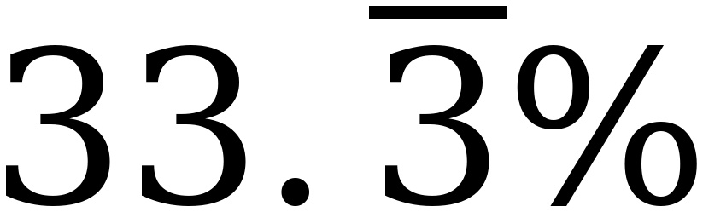
Whiteboards · Question 4 of 9
Answer.
0.333… × 100
required form:
Answer: 33.333…%
Grade 7 Accelerated · Unit 1 · Lesson 1 — Rewriting Numbers in Equivalent Forms
23

Slide 24
Whiteboards · Question 5 of 9
Boards up on three.
Write it as a decimal.
One value. Bar notation where it repeats.
Grade 7 Accelerated · Unit 1 · Lesson 1 — Rewriting Numbers in Equivalent Forms
24

Slide 25
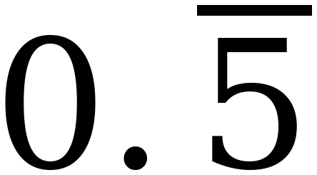
Whiteboards · Question 5 of 9
Answer.
the numerator is the repeating digit
required form:
Answer: 0.555…
Grade 7 Accelerated · Unit 1 · Lesson 1 — Rewriting Numbers in Equivalent Forms
25

Slide 26
Whiteboards · Question 6 of 9
Boards up on three.
0.777…
Write it as a fraction.
One value. Bar notation where it repeats.
Grade 7 Accelerated · Unit 1 · Lesson 1 — Rewriting Numbers in Equivalent Forms
26

Slide 27
Whiteboards · Question 6 of 9
Answer.
0.777…
which ninth repeats a 7 ?
Answer: 7/9
Grade 7 Accelerated · Unit 1 · Lesson 1 — Rewriting Numbers in Equivalent Forms
27

Slide 28
Whiteboards · Question 7 of 9
Boards up on three.
1.8666…
Write it in bar notation.
One value. Bar notation where it repeats.
Grade 7 Accelerated · Unit 1 · Lesson 1 — Rewriting Numbers in Equivalent Forms
28

Slide 29
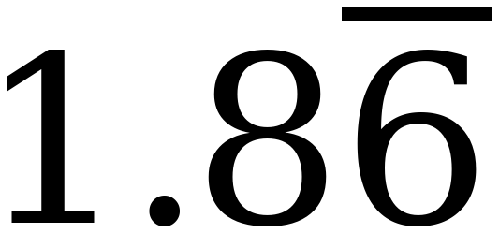
Whiteboards · Question 7 of 9
Answer.
1.8666…
the 8 happens once; the 6 is what repeats
required form:
Answer: 1.8 with the bar over the 6 only
Grade 7 Accelerated · Unit 1 · Lesson 1 — Rewriting Numbers in Equivalent Forms
29

Slide 30
Whiteboards · Question 8 of 9
Boards up on three.
7/20 5/12 9/8 4/15
Which of these give a decimal that STOPS?
Two of the four.
Grade 7 Accelerated · Unit 1 · Lesson 1 — Rewriting Numbers in Equivalent Forms
30

Slide 31
Whiteboards · Question 8 of 9
Answer.
7/20 5/12 9/8 4/15
20 and 8 are 2s and 5s; 12 and 15 carry a 3
Answer: 7/20 and 9/8
Grade 7 Accelerated · Unit 1 · Lesson 1 — Rewriting Numbers in Equivalent Forms
31

Slide 32
Whiteboards · Question 9 of 9
Take your time. Boards up when you have written it.
Ana says 3/8 and 0.38 are the same number. Is she right? Explain how you know.
Write your answer in sentences.
This one is written work. Show the division you used.
Grade 7 Accelerated · Unit 1 · Lesson 1 — Rewriting Numbers in Equivalent Forms
32

Slide 33
Whiteboards · Question 9 of 9
Answer.
Ana says 3/8 and 0.38 are the same number. Is she right? Explain how you know.
3 ÷ 8 = 0.375, and 0.375 is not 0.38
Answer: No — 3/8 is 0.375
Grade 7 Accelerated · Unit 1 · Lesson 1 — Rewriting Numbers in Equivalent Forms
33

Slide 34
IXL
Last five minutes.
1.
Open IXL and start today's skills.
2.
Work on paper where the question needs work. The answer box does not show it.
3.
Whatever you do not finish is tonight's practice.
4.
The skills for today are posted in Google Classroom.
Grade 7 Accelerated · Unit 1 · Lesson 1 — Rewriting Numbers in Equivalent Forms
34

